Slide 1
Selecting Movie Features to Predict Monetary Success and Popularity
By Kamarion Porter

Slide 2


Motivation

Slide 3


Motivation

Slide 4


Motivation

Slide 5


Motivation

Slide 6
Overview
Find columns for monetary success and popularity
Extract features from the dataset
Use chi-square for feature selection
Make logistic regression and Naive Bayes models

Slide 7

Logistic Regression
A linear regression transformation for binary data
Fit to ensure maximum predictive power

Slide 8

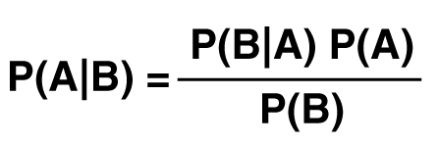
Naive Bayes
Bayes’ Theorem + Independence
A simple but powerful tool

Slide 9
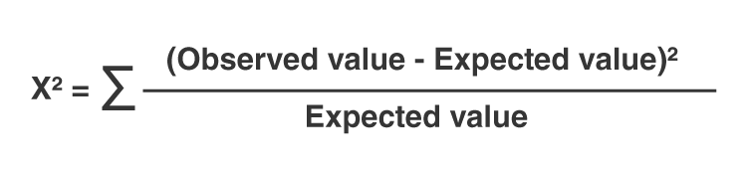
Chi-Square
Tests independence of inputs and outputs
Sensitive to sample size

Slide 10
Related Work
All used IMDb data
Latif and Afzal (2016)
Used feature selection and many classifiers to predict popularity
Abidi et al. (2020)
Used feature selection on inputs and outputs to predict popularity
Small-scale data
Dhir and Raj (2019)
Used correlation analysis to predict success
IMDb rating was his measure of success
Smaller scale data

Slide 11
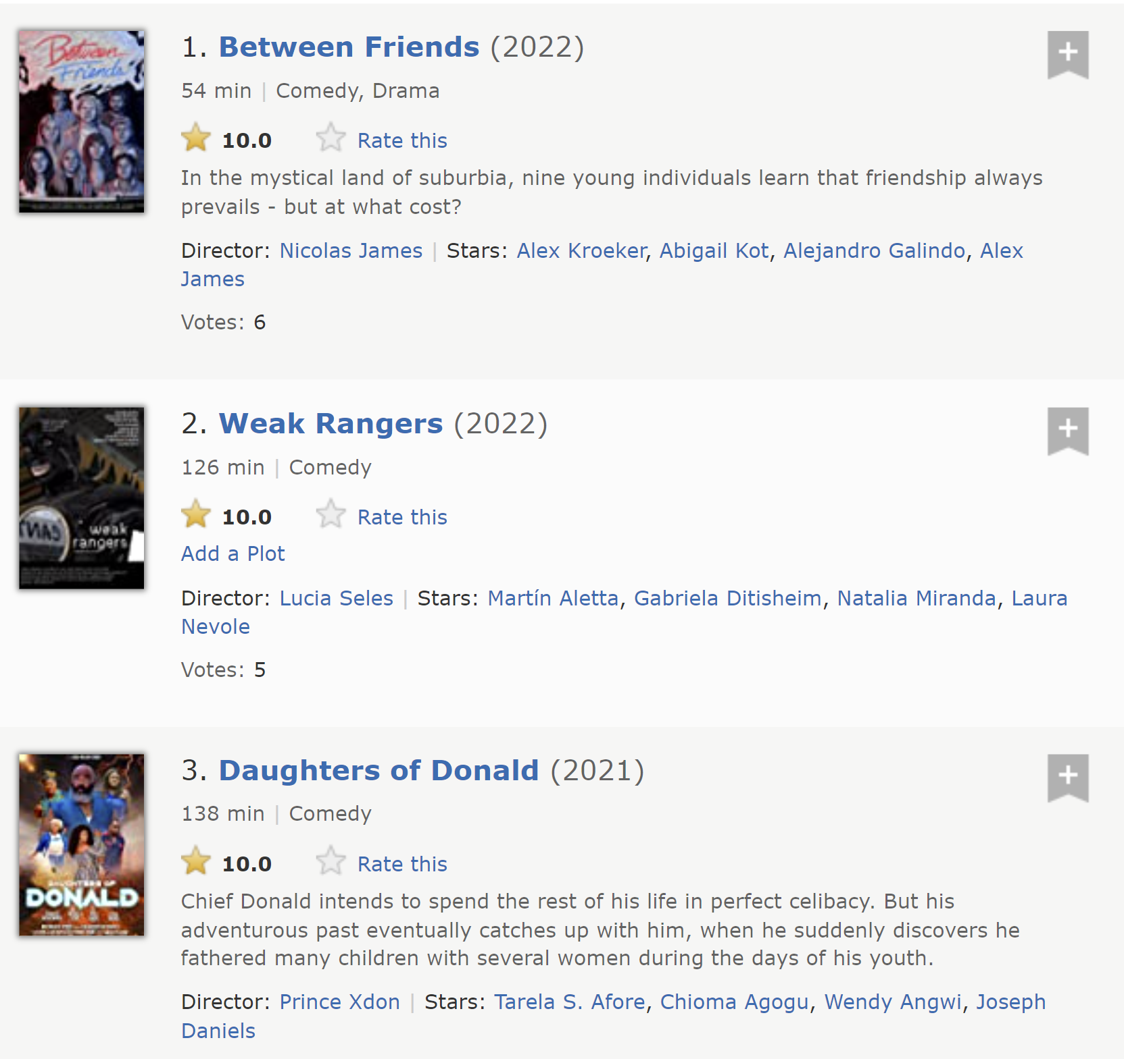
Choosing an Output: IMDb Rating?
New movies are heavily favored
Top comedies list on IMDb

Slide 12

Choosing an Output: Votes?
Terrible movies can have many votes
Worst rated movie on IMDB
93K votes

Slide 13
Choosing an Output: Adjusted Rating (AR)
AR = (Rating – 5.5) * ln(Votes)
5.5 is a neutral rating
10 to 100 votes vs. 10000 to 10090
Votes kept to measure notability

Slide 14
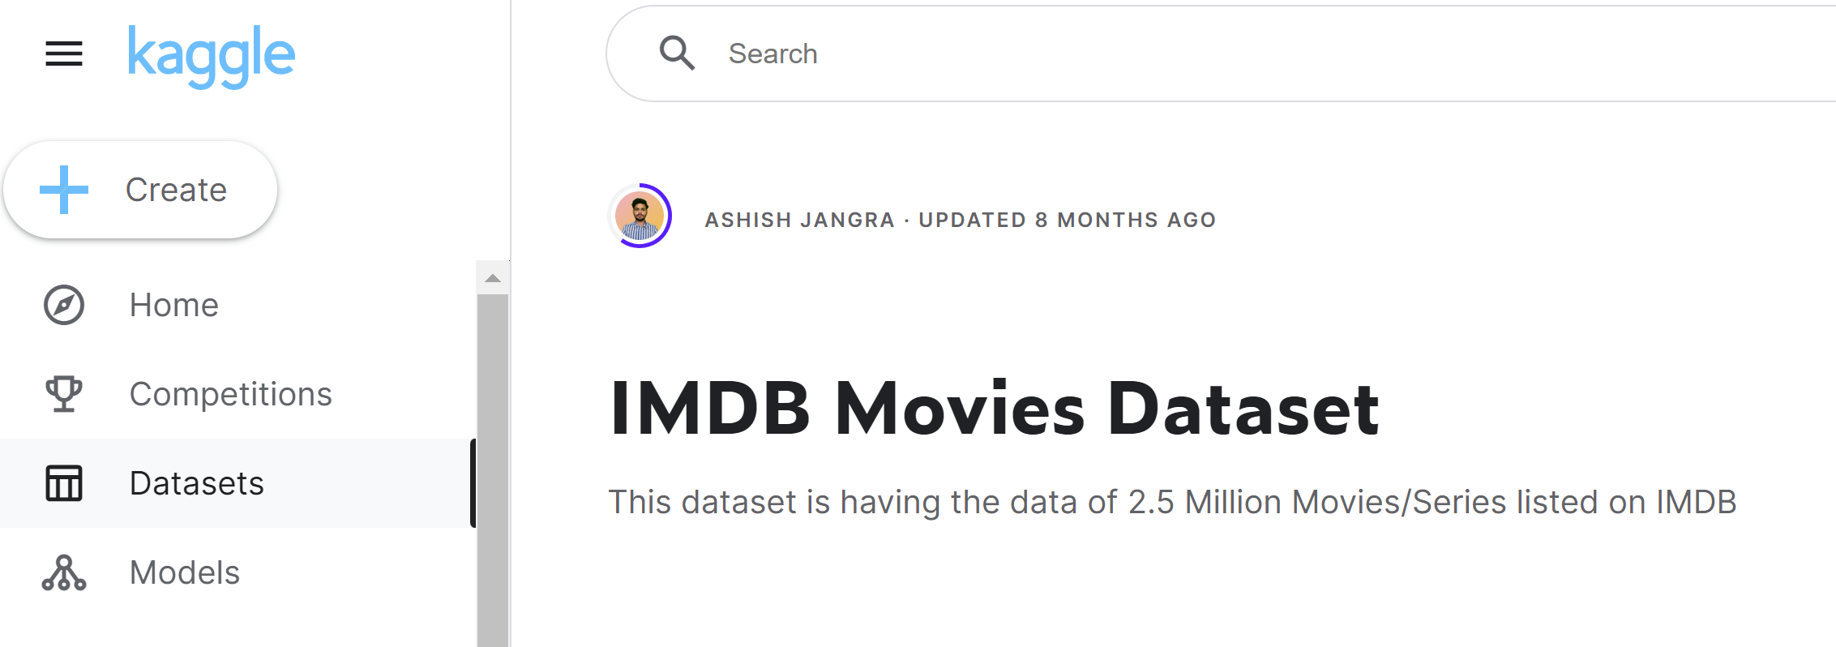
Data Filtering
Music Videos, Video Games, and Podcasts
Empty output values
11.0 Ratings
Year 2100

Slide 15
Data Filtering
~550K
Music Videos, Video Games, and Podcasts
Empty output values
11.0 Ratings
Year 2100

Slide 16
Creating Metrics and Models
Input/Output columns
Duration, Votes, Adjusted Rating, Gross income, Start Year, and all of the Genre categories (28)
Choose output
Encode the data
Ordinal Encoding
Calculate Chi-Square
Select Features
Fit and Test Model (Logisitic Regression and Naive Bayes)
Stats: accuracy, balanced accuracy, precision, recall, F1
Macro-Average used

Slide 17
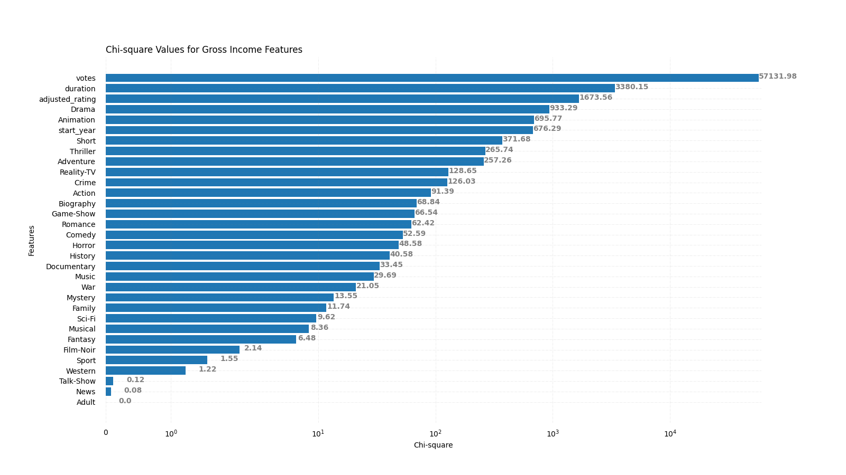
Chi-Square-Selected Features: Gross Income

Slide 18
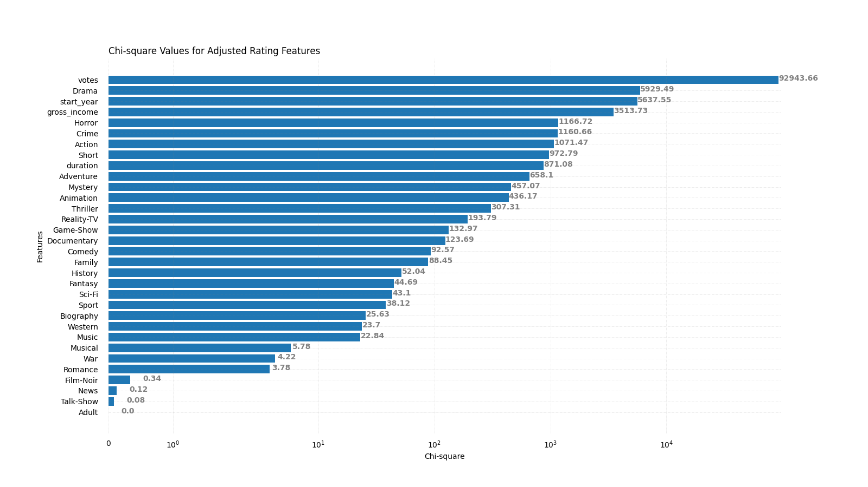
Chi-Square-Selected Features: Adjusted Rating

Slide 19
Logistic Regression Models
Statistic | GI (all) | GI (Top 3) | AR (all) | AR (Top 3)
Accuracy | 93.82 | 93.75 | 66.61 | 62.44
Balanced Accuracy | 25.72 | 22.25 | 18.32 | 13.81
Precision | 37.55 | 32.37 | 28.56 | 15.65
Recall | 25.72 | 22.25 | 18.32 | 13.81
F1 score | 27.35 | 21.52 | 20.02 | 14.02
Overall poor model performance
Accuracy is inaccurate
Precision is the best reliable statistic, which is best-case
Only one significant stat drop between full and top-3 models

Slide 20
Naive Bayes Models
Statistic | GI (all) | GI (Top 3) | AR (all) | AR (Top 3)
Accuracy | 92.50 | 93.24 | 64.64 | 65.26
Balanced Accuracy | 32.63 | 27.41 | 21.13 | 16.28
Precision | 32.30 | 28.61 | 22.01 | 16.96
Recall | 32.63 | 27.41 | 21.13 | 16.28
F1 score | 30.84 | 26.63 | 21.18 | 15.69
Overall poor model performance
More balanced statistics
No significant stat drops between full and top-3 models (and an accuracy increase)

Slide 21
Takeaways
Large datasets tend to be messy
Monetary Success and Popularity are tightly related
Drama movies win
More movie-based information needed to form a good classifier
Only the genre inputs refer to what the movie’s about

Slide 22
References
https://www.kaggle.com/datasets/ashishjangra27/imdb-movies-dataset
Abidi, Syed Muhammad Raza, et al. “Popularity Prediction of Movies: From Statistical Modeling to Machine Learning Techniques - Multimedia Tools and Applications.” SpringerLink, Springer US, 6 Jan. 2020, https://link.springer.com/article/10.1007/s11042-019-08546-5.
Dhir, Rijul, and Anand Raj. Movie Success Prediction Using Machine Learning ... - IEEE Xplore. 2018, https://ieeexplore.ieee.org/abstract/document/8703320.
Latif, Muhammad Hassan, and Hammad Afzal. Prediction of Movies Popularity Using Machine Learning Techniques. Aug. 2016, https://www.researchgate.net/profile/Hammad-Afzal/publication/311913687\_Prediction\_of\_Movies\_popularity\_Using\_Machine\_Learning\_Techniques/links/586253ce08ae6eb871ab0748/Prediction-of-Movies-popularity-Using-Machine-Learning-Techniques.pdf.

Slide 23
References
Brownlee, Jason. “A Gentle Introduction to Logistic Regression with Maximum Likelihood Estimation.” MachineLearningMastery.com, 27 Oct. 2019, https://machinelearningmastery.com/logistic-regression-with-maximum-likelihood-estimation/.
GeeksforGeeks. “Naive Bayes Classifiers.” GeeksforGeeks, GeeksforGeeks, 28 Mar. 2023, https://www.geeksforgeeks.org/naive-bayes-classifiers/.
Hayes, Adam. “Chi-Square (X2) Statistic: What It Is, Examples, How and When to Use the Test.” Investopedia, Investopedia, 13 Jan. 2023, https://www.investopedia.com/terms/c/chi-square-statistic.asp.

Slide 24

Thank You

